Slide 1

Microsoft Sustainability Manager Readiness Bootcamp Agenda
Session 1: Our sustainability story
Session 2: Carbon context
Session 3: End-to-end demo
Session 4: Data flow and data ingestion
Session 5: Calculations
Session 6: Analytics, reporting, and implementation
Session 7: Telling the solution story

Slide 2
Session 1: Our sustainability story
Our sustainability journey
Our customer promise
Microsoft Cloud for Sustainability
Microsoft Sustainability Manager
Record, report, and reduce emissions
Integrated cloud solutions

Slide 3

Decades of action
Microsoft history 2009-2019
Microsoft commitments 2020-2050
AI for Earth launch
LEED Gold certification for new datacenters
Carbon fee raised to $15
Water replenishment goal set
100% carbon neutral
Internal carbon fee instituted
2030
2025
Become carbon negative
Operate with 100% renewable energy
2009
2012
2016
2017
2018
2019
2030
2050
Become zero waste
Remove all historic emissions
2025
First carbon emission reduction goal
Zero-waste campus certification
Supplier carbon engagement in China launched
Net zero potable water Silicon Valley campus groundbreaking
Protect more land than Microsoft uses
2030
Become water positive

Slide 4

Moving from pledges to performance
Culture | Digital infrastructure | Business agility

Slide 5

Wherever you are in your sustainability journey, together, we can accelerate progress to reach our collective goals
Accelerate our shared sustainability journey
With over a decade of sustainability experience and continuous innovation integrated into our technology, using Microsoft products can help you decarbonize and accelerate your ESG (environmental, social, governance) journey
Embed sustainability in everything you do
With our technology and partner ecosystem, we bring integrated solutions to connect organizations and their value chain
Create new value with sustainability
We’re creating a community of collective learning and action, where data can be shared, insights delivered, and more common ways of working can be created

Slide 6



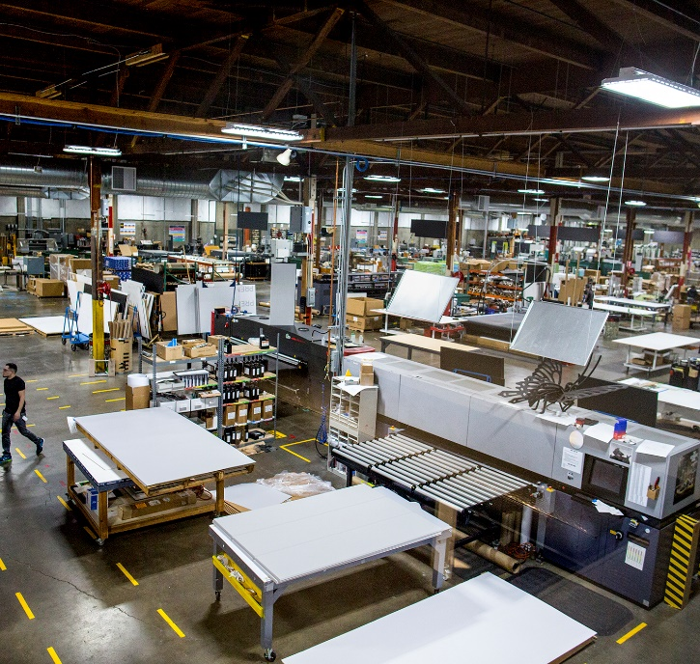

Microsoft Cloud for Sustainability accelerates sustainability progress and business growth
Unify data intelligence
Build a sustainable IT infrastructure
Reduce environmental impact of operations
Create sustainable value chains

Slide 7

Accelerate sustainability progress and business growth Microsoft Cloud for Sustainability
Foundational intelligence supports all scenarios
Security & Compliance
Reduce environmental Impact of operations
Unify DATA INTELLIGENCE
CREATE sustainable value chains
Build A sustainable it infrastructure

Slide 8

Microsoft Sustainability Manager
DATA
Record
Unify data intelligence to help organizations monitor and manage their sustainability performance
INSIGHTS
Report
ACTION Reduce

Slide 9

Record data
Automate data collection
Break down data silos with Microsoft Cloud for Sustainability data model
Calculate emissions across scopes
Generate more accurate results

Slide 10

Report insights
Visualize your impact
Track your performance against goals
Gain actionable insights to maximize progress
Streamline reporting
Notes:
Based on your recorded data, Microsoft Sustainability Manager enables you to visualize and report more accurate and reliable intelligence about your resource consumption, your environmental impact, and your sustainability progress.
Consistent visibility into your emissions activity allows you to track the progress of sustainability initiatives so you can adjust your strategy to make improvements faster, accelerating the pace of progress. You can slice and view the data with the granularity you need—whether you’re evaluating the impact of a single system, a location, your enterprise, or your entire value chain.
Insights are delivered through simple dashboards so you know which areas require more attention and if you’re on track to meet your sustainability commitments.
Rich visuals illustrate the patterns and trends occurring across your enterprise, and
Highlight areas of concern and possible solutions for goals that are at risk.
And this solution streamlines your reporting functions to employees, stakeholders, regulators, and the public.
It includes both export functions and configurable reports to ease preparation for audits and quantitative public reporting.
<CLICK>

Slide 11


Reduce your footprint
Set and track sustainability targets
Collaborate seamlessly
Use analytics to improve reduction activities
Reimagine fundamentals and drive lasting change
Notes:
Microsoft Sustainability Manager empowers you to get ahead of the unknowns and drive more effective reduction strategies.
Using the solution, you can set and track incremental and long-term sustainability targets—and build a roadmap to get you there. Scorecards and insights will help you stay on track.
It enables users and nonusers to seamlessly and securely collaborate about sustainability goals, emissions data, and insights.
Microsoft Teams integration in Cloud for Sustainability enhances engagement of sustainability managers with sustainability contributors from business system and process experts, facility managers, or c-suite leaders to energy providers or value chain partners. (Microsoft Teams collaboration and chat is currently a preview feature. Collaboration capability requires Microsoft Teams license.)
This feature accelerates productivity, by enabling, tracking, and storing sustainability conversations in context for easy access and reference.
To accomplish even more, you’ll connect Microsoft Sustainability Manager directly to other first party and third-party solutions—solutions that use virtual models to test scenarios or artificial intelligence to automate efficiencies.
Integrate the flow of data so you can monitor, refine, and scale your sustainability solutions faster.
And gain a more comprehensive, holistic view of your sustainability activities and your progress.
Our partner ecosystem will play a critical role in making the most of all these capabilities, with reduction strategies and industry extensions.
Together, integrated sustainability solutions will not only help you advance your goals, but through efficiency gains and improved margins, we can help you achieve cost savings and deliver value, too.
<CLICK>

Slide 12


Microsoft Sustainability Manager
Dynamic
calculation
Data model
Data visualization
DATA
Record
Connection catalog
Actionable
insights
ACTION
Reduce
INSIGHTS
Report
Partner
solutions
Reporting
Seamless collaboration
Goal tracking
Notes:
Microsoft Sustainability Manager delivers insights to help you accelerate every stage of your sustainability journey.
While today, this solution is focused on carbon emissions; ultimately, it will enable organizations to record, report, and reduce water and waste, too.
We’ll continue to regularly roll out new features and functionality.
<CLICK>

Slide 13
Solution view
Microsoft Sustainability Manager
Carbon
Water
Waste
Data capture service
Calculation service
Reporting service
Microsoft Cloud for Sustainability data model
Power Platform
Power Apps
Power Automate
Power BI
Dataverse
Data Lake
Microsoft Azure

Slide 14



Solution view
Operations
Sources
Microsoft Sustainability Manager
Ecosystem
Operations
Data sources
Sales
Report providers
ERP providers
Carbon
Water
Waste
Procurement
Data capture service
Calculation service
Reporting service
Cloud providers
Manufacturing
Microsoft Cloud for Sustainability data model
Governance partners
Farms
Agriculture
Logistics
Power Platform
Trading
partners
Power Apps
Power Automate
Power BI
Facilities
Partner solutions
Assets
Other data sources
Dataverse
Data Lake
Travel
Microsoft Azure

Slide 15
Accelerate sustainability progress and business growth Microsoft Cloud for Sustainability
Microsoft Sustainability Manager
Security & Compliance
Reduce environmental Impact of operations
Unify DATA INTELLIGENCE
CREATE sustainable value chains
Build A sustainable it infrastructure

Slide 16
Accelerate sustainability progress and business growth Microsoft Cloud for Sustainability
Security & Compliance
Reduce environmental Impact of operations
Unify DATA INTELLIGENCE
CREATE sustainable value chains
Build A sustainable it infrastructure

Slide 17
What did we learn in Session 1?
Our sustainability journey
Our customer promise
Microsoft Cloud for Sustainability
Microsoft Sustainability Manager
Record, report, and reduce emissions
Integrated cloud solutions

Slide 18

Give us your feedback
aka.ms/susbootcampsurvey

Slide 19

For resources and information about Microsoft Sustainability Manager, visit aka.ms/sustainabilityhub

Slide 20
Readiness bootcamp
Brandon Potter Group Product Manager, Microsoft Cloud for Sustainability
Alejandro Gutierrez Principal Product Manager, Microsoft Cloud for Sustainability
Rosie Mastrandrea Senior Director, Sustainability Product Marketing
Robin Smith Principal Product Manager, Microsoft Cloud for Sustainability

Slide 21
Session 2: Carbon context
Sustainability drivers and challenges
The need for global standards for carbon measurement
Definitions and concepts
Emission sources and CO₂e
Emission scopes
Reduction targets and goals
Emission factors and estimation factors

Slide 22

Our climate,
our future

Slide 23

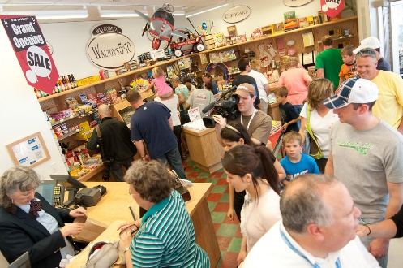



Sustainability drivers
Customers
Investors
Regulators
Employees
Notes:
Stakeholder and reporting pressures
Customer expectations
Material and product waste

Slide 24



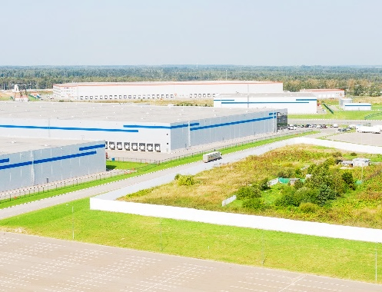

Sustainability challenges
Lack of standards
Slow manual processes
Siloed data
Value chain transparency

Slide 25

Transformation requires a data-first approach
Achieve data integrity and visibility across Scope 1, 2, and 3 emissions

Slide 26
Definitions and concepts

Slide 27



The greenhouse effect
GHGs
Greenhouse gases (GHGs) trap heat from the sun inside Earth’s atmosphere
Human activities release more carbon dioxide (CO₂) into the atmosphere than ecosystems can recycle
Trapped heat causes climate change

Slide 28







Sources of emissions
PCFs
H₂O
CH₄
HFCs
CO₂
CFCs
SF₆
O₃
N₂O
Energy generation (Electricity and heat)
Building
Transport
Industry
Agriculture, forestry, and other land use

Slide 29
Carbon dioxide equivalent (CO₂e) A unified metric for multiple greenhouse gases
Different human-emitted gases cause global warming at varying intensities and timescales
Carbon Dioxide (CO₂ )
Methane (CH₄)
Nitrous Oxide (N₂O)
Refrigerant Gases (HFCs, PCFs and CFCs)
Sulphur Hexafluoride (SF₆)
Water Vapor (H₂O)
Ozone (O₃)
Global warming potential (GWP) is the potency with which each gas traps heat from the sun
Sustainability Manager uses GWP to convert an organization’s multifaceted emissions into carbon dioxide equivalent (CO₂e)

Slide 30

Scopes and emissions across the value chain
CO₂
CH₄
N₂O
NFCs
PFCs
SF₆
Scope 2
INDIRECT
Scope 1
DIRECT
Scope 3
INDIRECT
Scope 3
INDIRECT
Purchased goods and services
REVISED
Purchased electricity, steam, heating & cooling for own use
Transportation and distribution
Leased assets
Company facilities
Investments
Capital goods
Employee commuting
Processing of sold products
Franchises
Fuel and energy related activities
Transportation and distribution
Business travel
Company vehicles
Use of sold products
Leased assets
Waste generated in operations
End-of-life treatment of sold products
UPSTREAM ACTIVITIES
REPORTING COMPANY
DOWNSTREAM ACTIVITIES
“Technical Guidance for Calculating Scope 3 Emissions,” Greenhouse Gas Protocol
Notes:
Organizations seeking to reduce carbon emissions are juggling factors that aren’t all within their direct control.
Let’s take a moment to look more closely at what contributes to a single organization’s carbon footprint.
An organization’s greenhouse gas (GHG) emissions are measured in three scopes:
<CLICK>
Scope 1 emissions are the direct emissions that an organization’s activities create through use of fossil fuels, like exhaust from transport trucks or diesel generators.
<CLICK>
Scope 2 indirect emissions come from the production of the electricity or heat we use in our offices or plants.
<CLICK>
Scope 3 indirect value chain emissions come from all the other activities in which we’re engaged including supply chain emissions – both upstream and downstream. For organizations, this includes the emissions associated with the materials in its buildings, the business travel of its employees, and the full life cycle of its products, including the electricity customers may consume when using products.
These categories, outlined by the Greenhouse Gas Protocol, are designed to be mutually exclusive to avoid an organization double counting emissions among categories.
<CLICK>
Source: “Technical Guidance for Calculating Scope 3 Emissions,” Greenhouse Gas Protocol, World Resources Institute & World Business Council for Sustainable Development, 2013, https://ghgprotocol.org/sites/default/files/standards_supporting/Intro_GHGP_Tech.pdf

Slide 31
What are emission targets?
Carbon targets
Carbon neutral: A company becomes carbon neutral by reducing their emissions and/or paying others to not emit an equivalent of their remaining emissions.
Carbon net zero: An organization is considered net zero carbon when it removes as much carbon as it emits.
Carbon negative: A company is carbon negative when it removes more carbon than it emits each year.
Visit ghgprotocol.org for more information

Slide 32
The role of emission factors
The volume of GHG emissions and their very low concentrations in the atmosphere make it very hard to measure specific GHG emissions resulting from a particular action.
Using emission factors, we can estimate emissions created by an activity.
Activity x emission factor = emission
Important:
Efficiencies and changes in an activity can impact the emission factors—so it’s important to constantly update the factors based on latest standards and research
An emission factor shows the quantity of GHGs emitted in relation to a particular activity, in CO₂–equivalent (CO₂e) per accounting unit of the activity Example: Lbs CO₂e/KWh

Slide 33
Using estimation factors
New slide – design, please clean up
In the absence of activity data, organizations need a way to use the data they do have (often called proxy data) to calculate an estimation of activity data. These are called estimation factors.
Proxy data x estimation factor = activity
How do I know if I need estimation factors?
They’re useful when activity data cannot be directly obtained, such as converting leased space to electricity or in converting hotel night stays to natural gas used.
An estimation factor estimates the activity data for given proxy data the same way an emission factor estimates emissions from actual activity data, by a mathematical unit conversion.
Example: 500 squarefeet = 15 kWh

Slide 34
What did we learn in Session 2?
Sustainability drivers and challenges
The need for global standards for carbon measurement
Definitions and concepts
Emission sources and CO₂e
Emission scopes
Reduction targets and goals
Emission factors and estimation factors

Slide 35
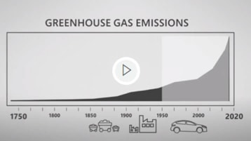
Understanding the math behind net-zero carbon
Microsoft Chief Environmental Officer Lucas Joppa explains carbon math
Watch the video:
Aka.ms/carbonmathvideo

Slide 36
Give us your feedback
aka.ms/susbootcampsurvey

Slide 37
For resources and information about Microsoft Sustainability Manager, visit aka.ms/sustainabilityhub

Slide 38
Readiness bootcamp
Brandon Potter Group Product Manager, Microsoft Cloud for Sustainability
Alejandro Gutierrez Principal Product Manager, Microsoft Cloud for Sustainability
Rosie Mastrandrea Senior Director, Sustainability Product Marketing
Robin Smith Principal Product Manager, Microsoft Cloud for Sustainability

Slide 39
Session 3: End-to-end demo
Goal-setting
Connecting to data
Dashboard & data exploration
Influencers & top segments
Emission scopes & analysis
Activity data
Setting up calculations
Using calculation profiles
All emission entities

Slide 40
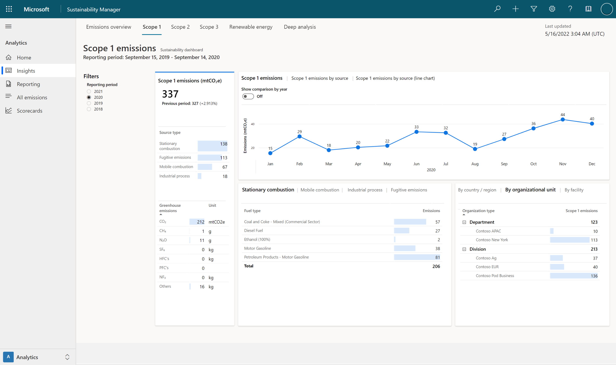
Note to editors: This is for 10:59 in the video where Source types are explained

Slide 41
What did we learn in Session 3?
Goal-setting
Connecting to data
Dashboard & data exploration
Influencers & top segments
Emission scopes & analysis
Activity data
Setting up calculations
Using calculation profiles
All emission entities

Slide 42
Give us your feedback
aka.ms/susbootcampsurvey

Slide 43
For resources and information about Microsoft Sustainability Manager, visit aka.ms/sustainabilityhub

Slide 44
Readiness bootcamp
Brandon Potter Group Product Manager, Microsoft Cloud for Sustainability
Alejandro Gutierrez Principal Product Manager, Microsoft Cloud for Sustainability
Rosie Mastrandrea Senior Director, Sustainability Product Marketing
Robin Smith Principal Product Manager, Microsoft Cloud for Sustainability

Slide 45
Session 4: Data flow and data ingestion
Solution focus areas
Types of data
Processes and data flow
Data templates
Data ingestion methods

Slide 46
Solution
focus areas
2
Data Ingestion
1
3
Organization Setup
Emission Calculations
Solution
5
4
Goals and Scorecard
Insights and reporting
Notes:
Let’s examine the key focus areas of Cloud for Sustainability, and what different professionals within your organization may be prioritizing.
IT-focused professionals may be focused on the setup and data ingestion process.
Sustainability officers may be focused on calculations, insights, scorecards, and goals in the solution.
Operations managers will be instrumental in defining the organization, providing data, and making use of the intelligence they gain about their own operations.
Business leaders will be interested in the analytics, reports, and insights that are generated by the solution.
As you set up the solution, you’ll begin by defining the scope of your organization and the locations where you operate. For example, how many countries do you operate in?
The answers will help us understand the type of regulations you will need to address in each country, the emission factors, the type of data we need to collect, and the granularity of the data and insights we need to produce to help you track and report your sustainability progress and meet your emissions reduction goals. ___ The second area of focus is data ingestion, which includes identifying the different sources that generate emissions and then connecting those data sources.
In this step, we determine the different scopes and activities that contribute to your organization’s emissions.
___ Once we have the data, we set up the conditions to calculate emissions based on the supporting data, activities, and emission factors.
___ Once we have all of that information, we can generate insights and reporting, and help organizations set goals and create scorecards to monitor their progress.

Slide 47


Defining the organizational boundaries
Scope
Operations
Blueprint
Hierarchy
Units
Having a clear understanding of the organization will drive a successful platform enablement that will fulfill the right level of recording, reporting and plans for reduction.
Industry
Countries
Regions
Organization
Periods
Facilities
Solution enablement may be done on an incremental basis but defining attributes properly at the start will set up organizations for success with a solid configuration architecture that can scale.
Goals
Regulations
Methodologies
Notes:
Defining all the attributes of the organization up-front is important.
For example, some countries require you to segregate data by regions. That requires accounting for the use of different units of measurements in different countries. (Some countries use imperial units; some use the metric system.) This impacts calculations and formulas.
Understanding this level of detail will help us create a blueprint for the organization in this solution.
And defining attributes properly at the start sets you up for success with a solid configuration and an architecture that can scale.

Slide 48




Continuous stream of supporting data
Foundation for successful recording, reporting, and reduction strategies
Organization
Facilities
Reference data
Libraries
We should expect a constant evolution of organizations’ operations and improvements—therefore, the supporting data to continuously calculate carbon footprint can also change Connectors for continuous streams of this data can also be implemented
Notes:
We understand that this foundational information—the supporting data—will change over time.
The structure of businesses can change, for example, as you add new operations or facilities or product lines.
These types of updates can be handled manually, but it’s most efficient to use connectors to business systems or other sources to enable a continuous stream of data. A live stream of data is a more reliable way of keeping supporting data accurate and complete. That way, changes to an organization, facilities, or reference data elements don’t disrupt your ability to do carbon calculations at scale—changes are made dynamically in the solution.

Slide 49

Types of data
Dataverse
Data lake
Master data
System and master data that will support the continuous flow of activity data, allowing for near real-time emissions calculations
Transactional data
Activity and calculated emissions data; this data will be ingested periodically
This is where recording happens
Analytical data
Data resulting from periodic calculations and combines master data; stored for optimal analytical purposes
Reporting and reduction goals are use this data
Notes:
There are three types of data in the solution: supporting data, transactional data, and analytical data.
We will start with supporting data, which is system or master data that flows continuously and supports near real-time emissions calculations.
The transactional data is the activity and includes everything that can produce emissions. We do calculations with transactional data which is ingested periodically.
All the supporting (or master data) and transactional data is stored in Dataverse.
Finally, analytical data is used to feed all the insights and the scorecards.
The analytical data is stored in data lakes. Storing analytical data in data lakes gives organizations the power to do more advanced analytics in the future in machine learning and AI scenarios.

Slide 50
Recommended practices Supporting data
Organization
Facilities
Reference data
Libraries
Identify regulatory requirements in countries where operations exist
Specify units and conversions to avoid calculation errors
Define the solution landscape in terms of reporting needs and level of granularity
Notes:
Here are a few important considerations for setting up supporting data.
Regulatory requirements in different countries will dictate your needs, determining things like emission factors.
Keep units and conversions in mind because the wrong units or conversions can cause calculation failures. We do have a method to easily convert units of measurement. As long as you have conversions set up in the application, your calculations will work.
Consider the level of granularity you’ll need for reporting purposes. For example, if you’ll need to track a specific line of business, you’ll want to set up “Facility + Line of business” in the name, as in: “Contoso Pod facility – Organic beans.”
Let’s walk through a real-world example recently faced by one of our customers.
This organization has facilities that they call plants. They manufacture three different products in each plant and want to track emissions by three different segments within each plant.
They use different energy providers for each of those lines of business. Therefore, the emission factors can be different, even inside of the plant.
We faced a challenge when defining the facility type, and we discovered that we needed to expand the solution to support multiple dimensions within a facility.
We’re going to address that, so they can identify facility plant #1 for production of product A, B, or C.
That way, we’ll have enough granularity to do proper carbon math for those products within each facility, connected to their own data and emission factors.

Slide 51
Real-world example Tracking emissions by segment within plants
Plant
Product A
Energy source 1
Total emissions per plant
Product B
Energy source 2
Product C
Energy source 3
Notes:
One of our customers has facilities that they call plants. They manufacture three different products in each plant and want to track emissions by three different segments within each plant.
They use different energy providers for each of those lines of business. Therefore, the emission factors can be different, even inside of the plant.
We faced a challenge when defining the facility type, and we discovered that we needed to expand the solution to support multiple dimensions within a facility.
We’re going to address that, so they can identify facility plant #1 for production of product A, B, or C.
That way, we’ll have enough granularity to do proper carbon math for those products within each facility, connected to their own data and emission factors.

Slide 52








Processes and data flow
System
Unit groups and conversions; report settings
Reference data
Types of instruments, vehicles, fuels, or industrial processes
Organization
data
Defines organizational and facility information
Libraries
Emissions factors and factor mappings
1 Master data
2 Record
Activity
Activity data reflects operational boundaries and is organized into 8 sources of Scope 1 and 2 emissions and 15 categories of Scope 3 emissions
Emissions
Calculated using activity data combined with relevant emission factors
3 Report
Analytics
Calculations
Reports
4 Reduce
Scorecards
Notes:
Let’s look at the process in greater detail. As we’re setting up the solution, we’ll start with collecting master data:
In the System, we preload unit groups and unit conversions, using the most common forms used for carbon accounting.
Reference Data includes data types such as contractual instrument types, vehicle and fuel types or industrial process types. We can establish connectors to reference data sources.
The same is true for Organization Data. We’ll define company information and facilities here, and we can also establish direct connections to these data sources.
The Libraries contain emission factors and factor mappings.
<CLICK>
In step two, Activity data represents the operational boundaries, including everything that is in scope to track that contributes to an organization’s emissions. This will look different for every organization, depending on what they do as part of their business—service organizations, for example, may be focused on different scope categories than industrial or manufacturing organizations.
After master data and activities are accounted for, the Emissions are calculated using activity data combined with relevant emission factors.
<CLICK>
And once you’ve calculated emissions, the results and insights are all generated through Analytics and displayed in dashboards and out-of-the-box Reports. <CLICK>
The solution populates Scorecards used to help track progress towards your goals.
<CLICK>

Slide 53
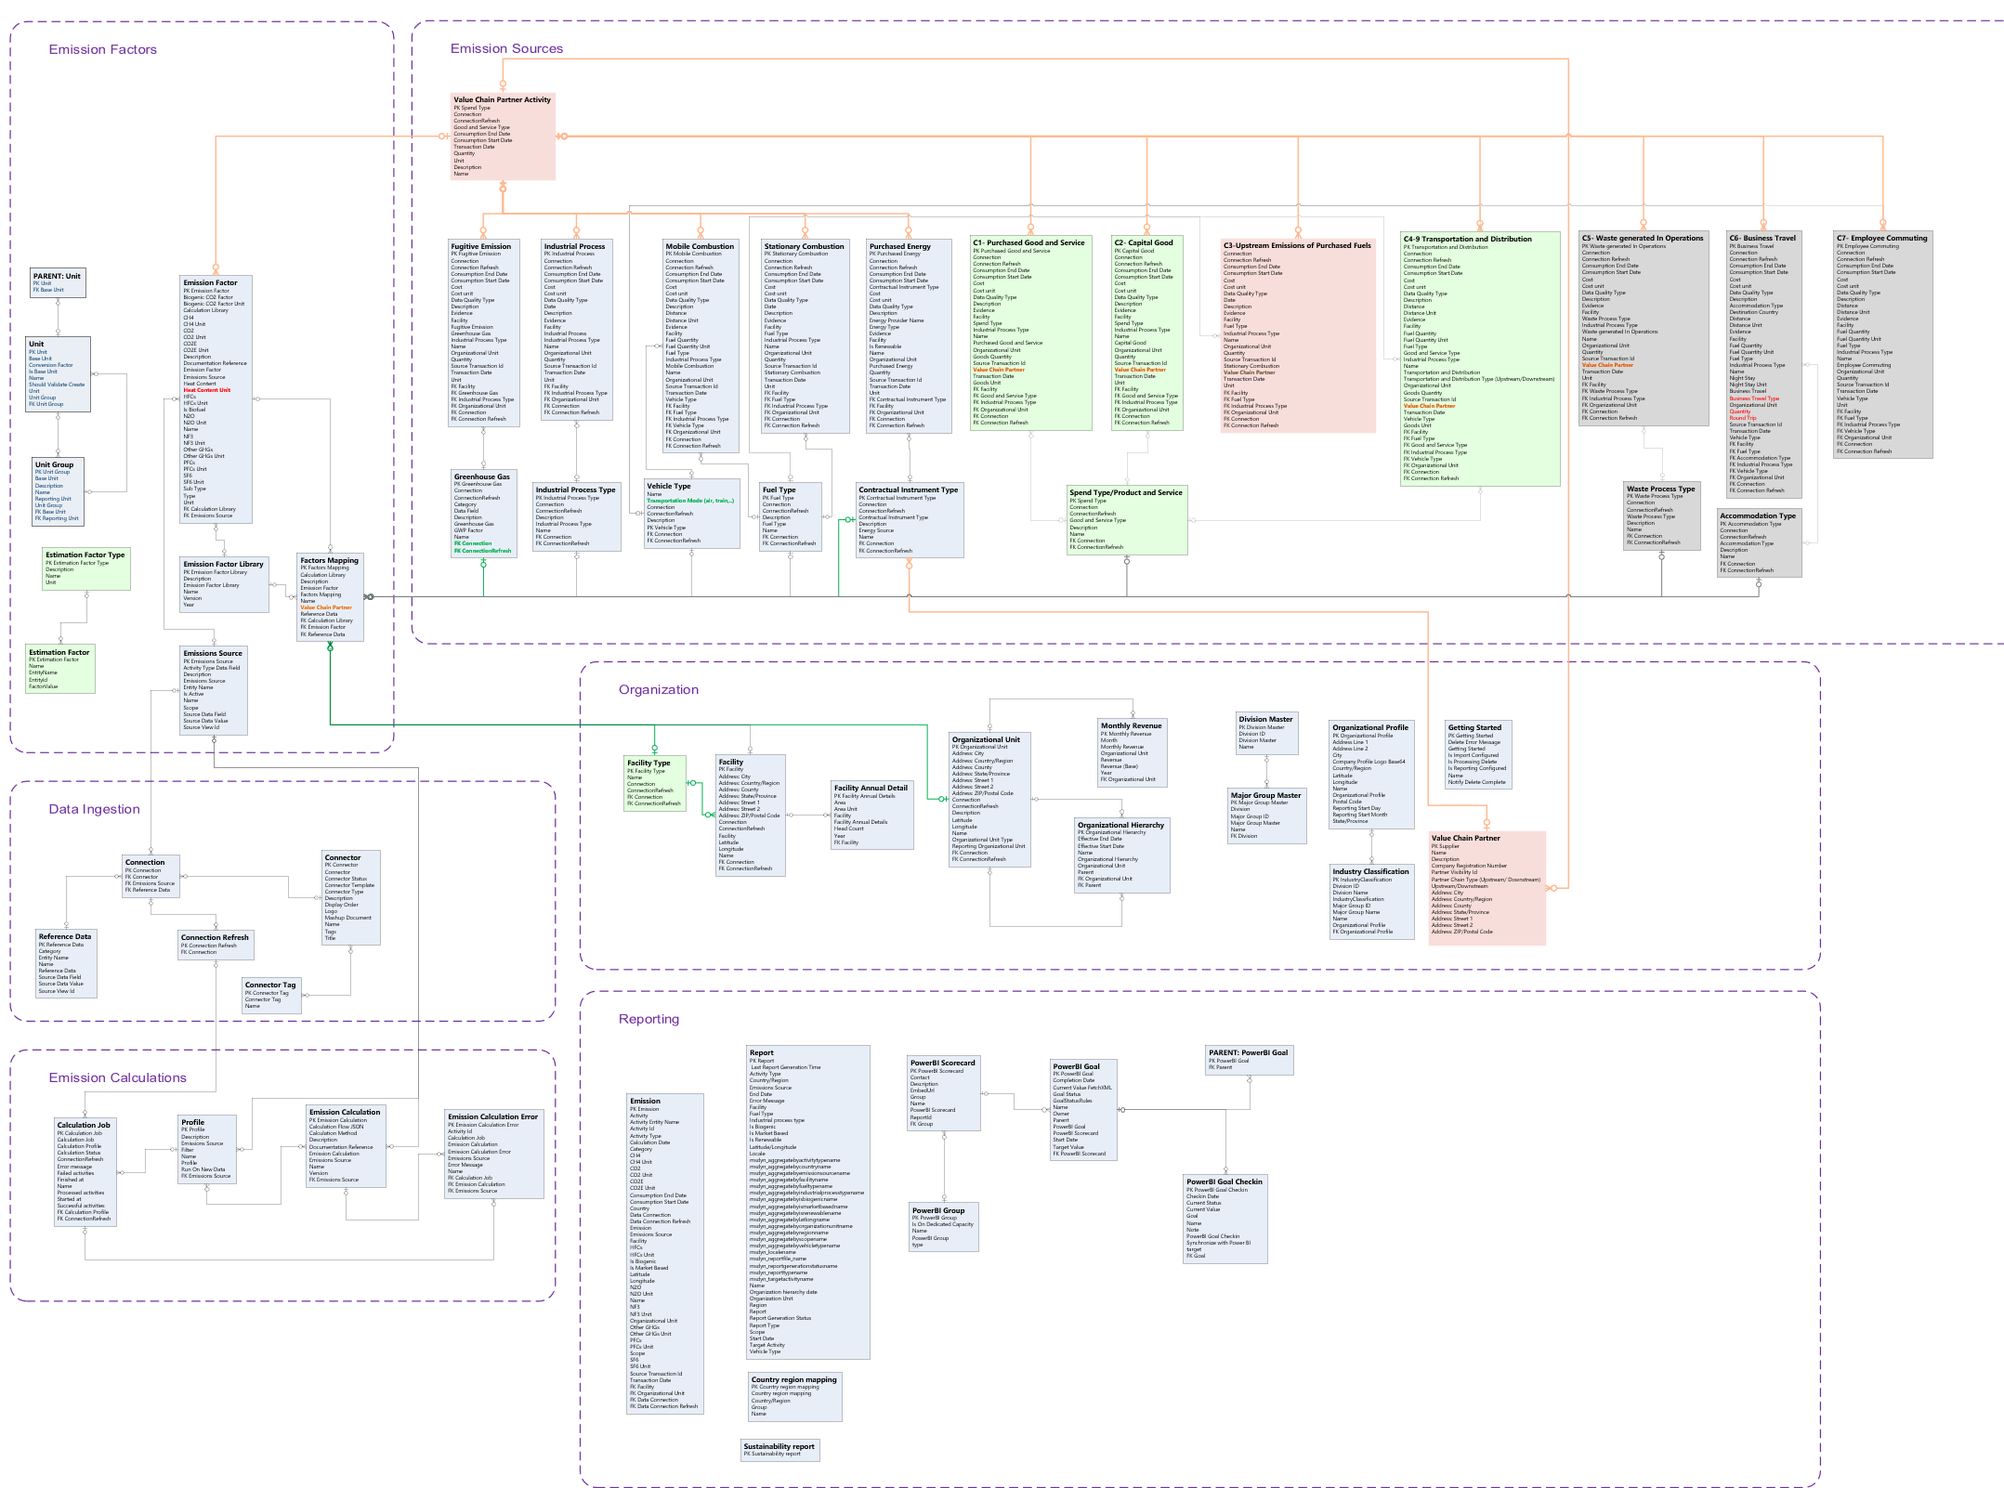

Microsoft Cloud for Sustainability data model
Emission factors
Emission sources
Organization
Data ingestion
Reporting
Emission calculations
Notes:
Behind this process, of course, is the Sustainability Common Data Model that centralizes data from various sources—streamlining data ingestion, integration, calculations, and reporting.
The groups of data shown here are related and dependent on one another.

Slide 54





Flexible data ingestion methods
Manual
File based
New connection
Prebuilt
connectors
Manually entered data in the application
Using Excel, CSV files, etc.
To a database, blob storage, or any supported connection by Power Query
.
In partnership with data providers, no need for data mapping or transformation
.

Slide 55
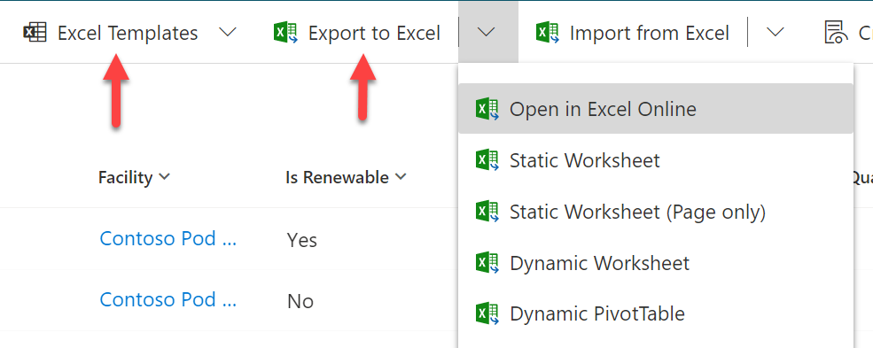


Templates
Download data templates to simplify data preparation. These templates will help align your data with the Microsoft Cloud for Sustainability data model.
Some columns are mandatory; others are recommended
Notes:
In the next few minutes, we’ll explore how to pull in data by importing files, using direct connections, or using power queries.
No matter how we’re pulling in data, the data will need to be organized to some degree. That’s why we’ve created templates: to help you organize data in destination files.
The templates define the columns needed to cleanly import data using different import methods. Some columns are mandatory, others are recommended. This information is all in the templates.

Slide 56
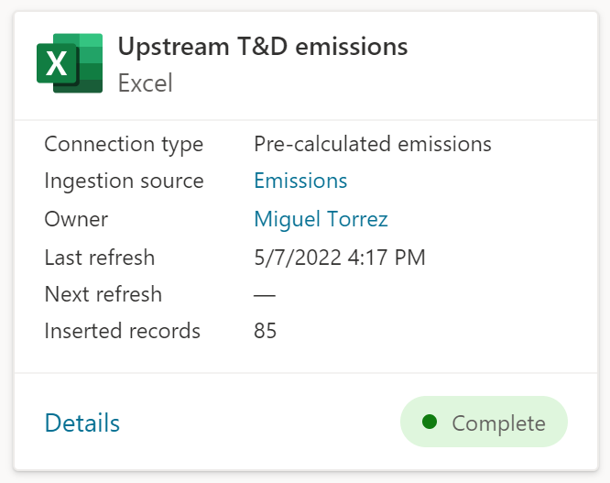
Monitoring data ingestion
Importing data allows you to conduct a one-time import or to schedule an import for the future.
During import you can:
Monitor and troubleshoot.
Remove and replace data as you work. Note: This may trigger new calculations.
Import job

Slide 57



Recommended practices Data ingestion
Plan your approach based on organization landscape, technical capabilities, and source data format.
Partner with IT to manage data ingestion.
Define roles for data management security.
Start simple with manual or file-based data ingestion methods.
Be flexible about how your organization imports data; blend methods where possible.

Slide 58
What did we learn in Session 4?
Solution focus areas
Types of data
Processes and data flow
Using data templates
Data ingestion methods

Slide 59
Give us your feedback
aka.ms/susbootcampsurvey

Slide 60
For resources and information about Microsoft Sustainability Manager, visit aka.ms/sustainabilityhub

Slide 61
Readiness bootcamp
Brandon Potter Group Product Manager, Microsoft Cloud for Sustainability
Alejandro Gutierrez Principal Product Manager, Microsoft Cloud for Sustainability
Rosie Mastrandrea Senior Director, Sustainability Product Marketing
Robin Smith Principal Product Manager, Microsoft Cloud for Sustainability

Slide 62
Session 5: Calculations
How Sustainability Manager runs calculations
Building calculations
Models
Profiles
Activity data

Slide 63
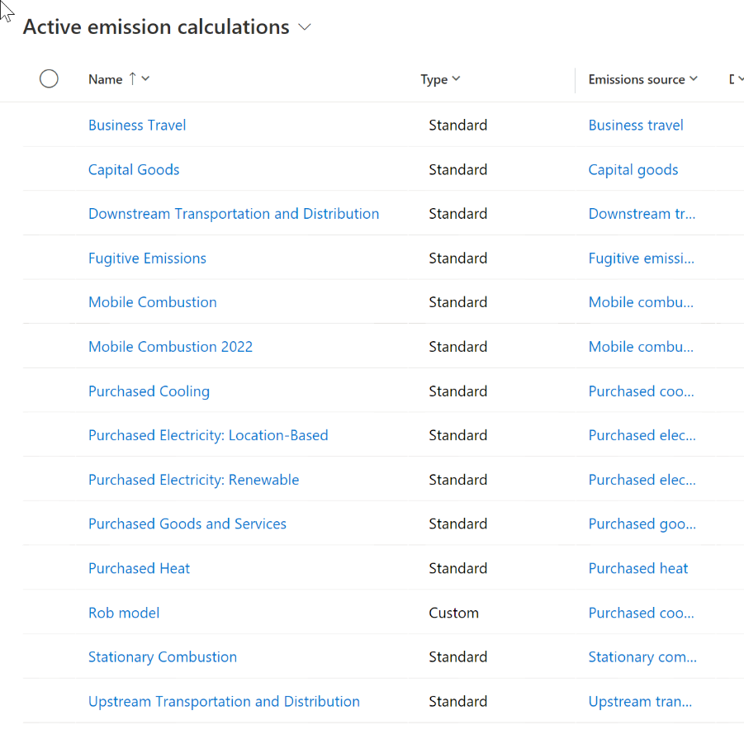
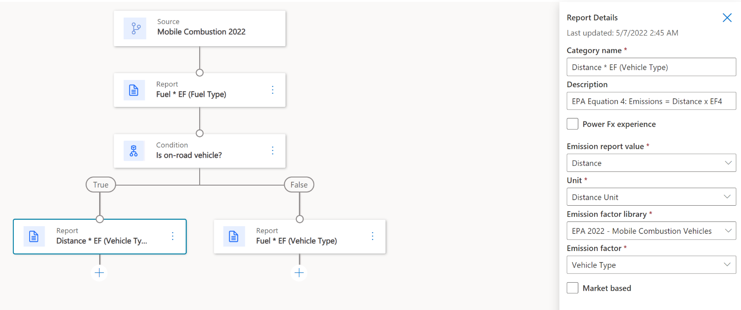
Navigation
Selected calculation step
definition
Collection of models
Formula flow

Slide 64






Calculations End-to-end process
Emissions
Model contains the formulas and connects to the specific emission factor based on the scenario.
Factor mapping connects a factor to specific reference data based on a specific data pattern. Mapping simplifies the models to be created.
Activity
Model
Profile
Library contains the emission factors and factor mappings for a specific period.
Greenhouse gases GWPs
Profile connects the model with activity data and calculates the emissions resulted from the activity
Library
Factors
Factor mappings

Slide 65




Models The formula in action
Emissions
Step 1: Determine the amount of electricity purchased.
Step 2: Determine emission factors.
Step 3: Calculate emissions. Use Equation 1 to calculate the emissions of CO₂, CH₄, and N₂O.
Multiply the emissions of CH₄ and N₂O by the respective global warming potential (GWP) to calculate CO₂-equivalent emissions.
Activity
Model
Profile
Greenhouse gases GWPs
Library
Factors
Factor mappings

Slide 66
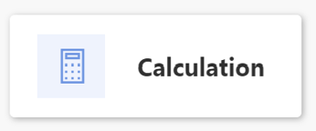
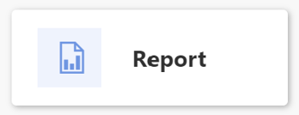
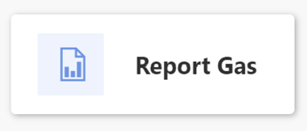
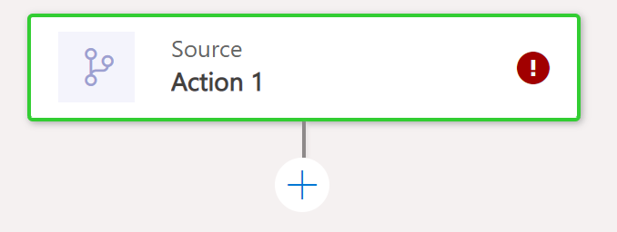
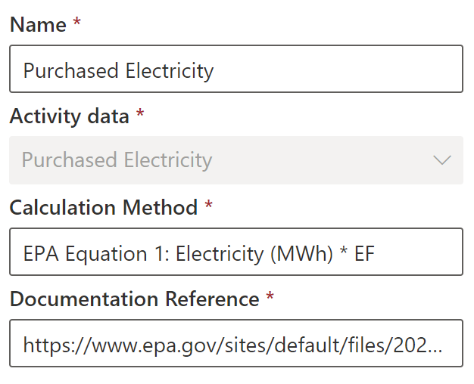

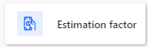
Actions
Models Formula components
Calculation directly done in the formula without the need to consume emission factors from the library.
Output stored on a defined variable.
Calculation using emission factors from the library dynamically, based on the context defined.
Can use an output value from a previous calculation. Market-based can be flagged so that Analytics will consider this emission this way.
Calculation using greenhouse GWP factors
Source
Mandatory definition missing
Next action in the calculation flow
Source data to be used for the calculation
Decision path (True/False)
Enable multiple scenarios per calc model with conditions.
Estimation Factors enable calculating real activity data from proxy data. For example, convert square footage to kwh.

Slide 67

Co2-equivalent emissions data
Multiple gases cause global warming, including:
Carbon dioxide (Co2)
Methane (CH4)
Nitrous oxide (N2O)
Different gases behave differently
Helpful to have a unified metric to describe global warming impact.
Multiplying emissions by global warming potential (GWP) provides Co2-equivalent data, an easily-understandable figure.
GWPs are pre-loaded into Sustainability Manager.
Notes:
One great aspect of Sustainability Manager is that it can produce Co2-equivalent emissions data.
There are multiple gases emitted by human activity that contribute to global warming, including carbon dioxide, or Co2, methane, or CH4, and nitrous oxide, or N2O. These gases trap heat at different levels of efficacy and remain in the atmosphere for different lengths of time. These complexities can make it hard to describe the true global warming impact of economic activity, which is why it can be helpful to have a unified metric.
CO2-equivalent data takes methane and nitrous oxide emissions and multiplies them by the global warming potential, or GWP, of those gases to create CO2-equivalent. That creates a unified and easily-understandable figure.
GWPs are pre-loaded into Sustainability Manager.

Slide 68
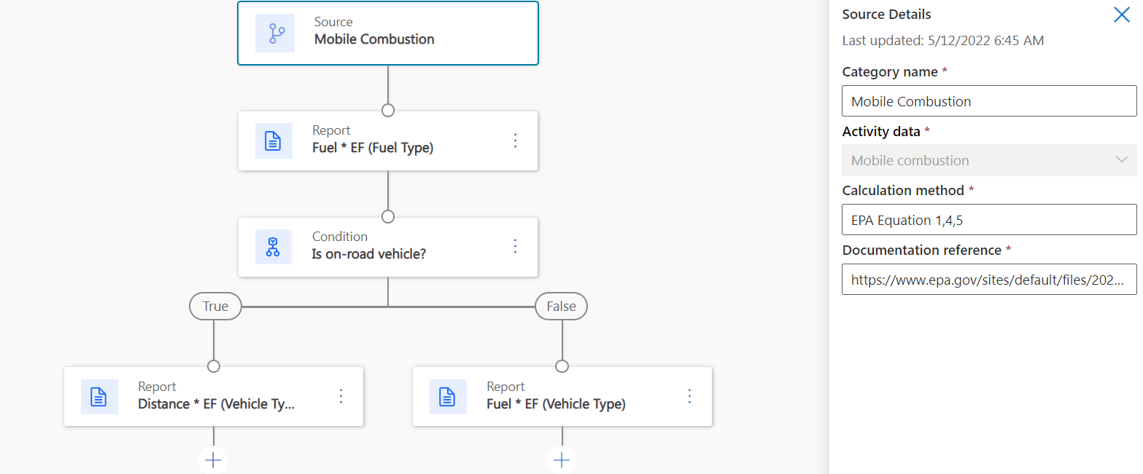
Models Case: Mobile combustion (EPA)
Fuel type Fuel use Distance traveled (for on road vehicles) Fuel economy (if either fuel use or distance traveled is unavailable) Vehicle type Emissions control technology and/or model year

Slide 69
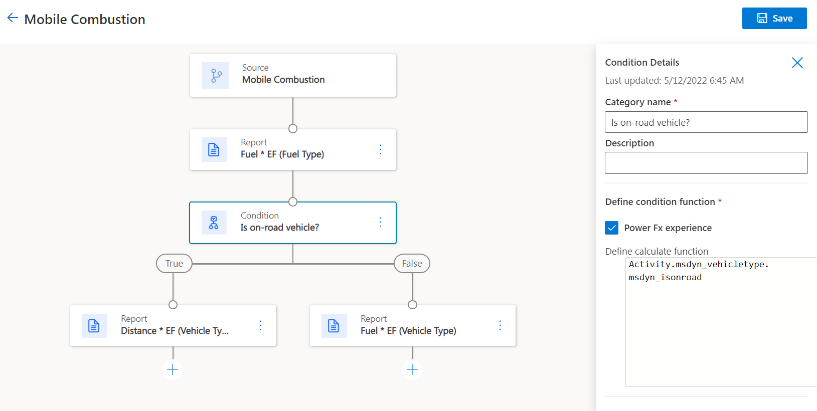
Models Case: Mobile combustion (EPA)
Condition can use Power Fx experience for a custom formula decision making using all entities and fields available across the solution Power Fx is a low-code human-friendly language used across the Power Platform which makes common programming tasks easy for business users or developers. Microsoft Power Fx overview - Power Platform | Microsoft Docs
Fuel type Fuel use Distance traveled (for on road vehicles) Fuel economy (if either fuel use or distance traveled is unavailable) Vehicle type Emissions control technology and/or model year

Slide 70
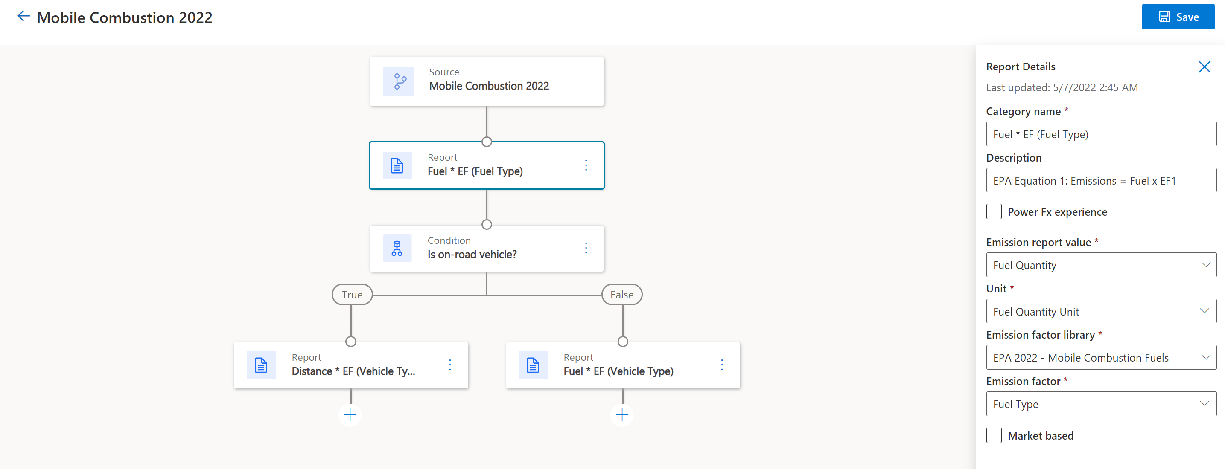
Models Case: Mobile combustion (EPA)
Fuel type Fuel use Distance traveled (for on road vehicles) Fuel economy (if either fuel use or distance traveled is unavailable) Vehicle type Emissions control technology and/or model year
Report will calculate the emissions based on the fuel consumed multiplied for the fuel type emission factor using the EPA library.

Slide 71
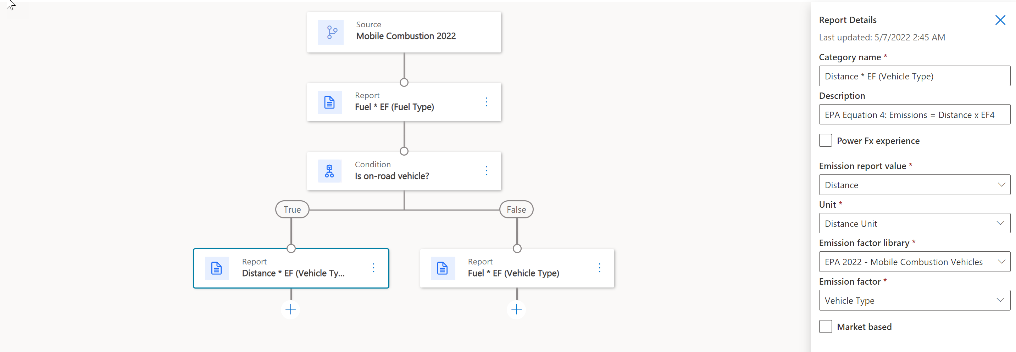
Models Case: Mobile combustion (EPA)
Fuel type Fuel use Distance traveled (for on road vehicles) Fuel economy (if either fuel use or distance traveled is unavailable) Vehicle type Emissions control technology and/or model year
Report will calculate the emissions based on the fuel consumed multiplied for the fuel type emission factor using the EPA library.

Slide 72
Models Case: Mobile combustion (EPA)
Fuel type Fuel use Distance traveled (for on road vehicles) Fuel economy (if either fuel use or distance traveled is unavailable) Vehicle type Emissions control technology and/or model year
Report will calculate the emissions based on the fuel consumed multiplied for the fuel type emission factor using the EPA library.

Slide 73
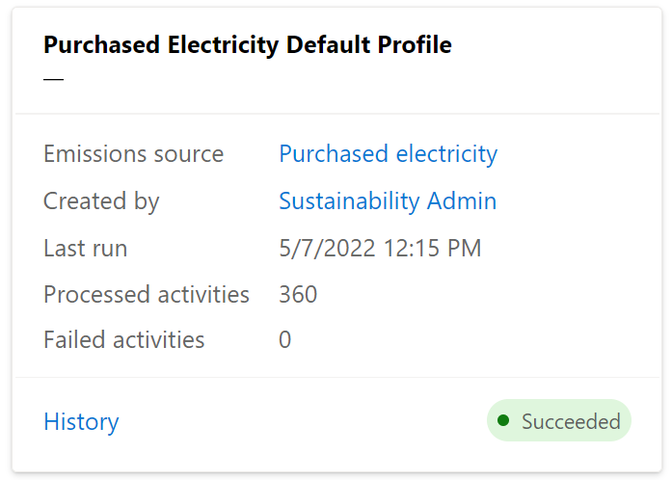

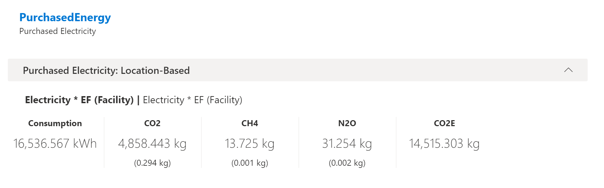
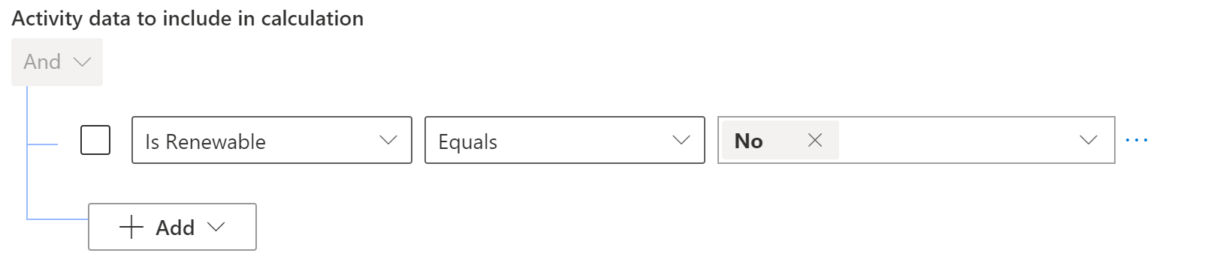
Profile The process of connecting the activity with the formula
Profile is a job setup that will execute as new activity is refreshed or will execute on demand.
The outcome will be the calculated emissions and can be previewed for validation before final setup.
Previous calculations can be removed.
Profile can also run for specific set of activity data if configured that way.

Slide 74
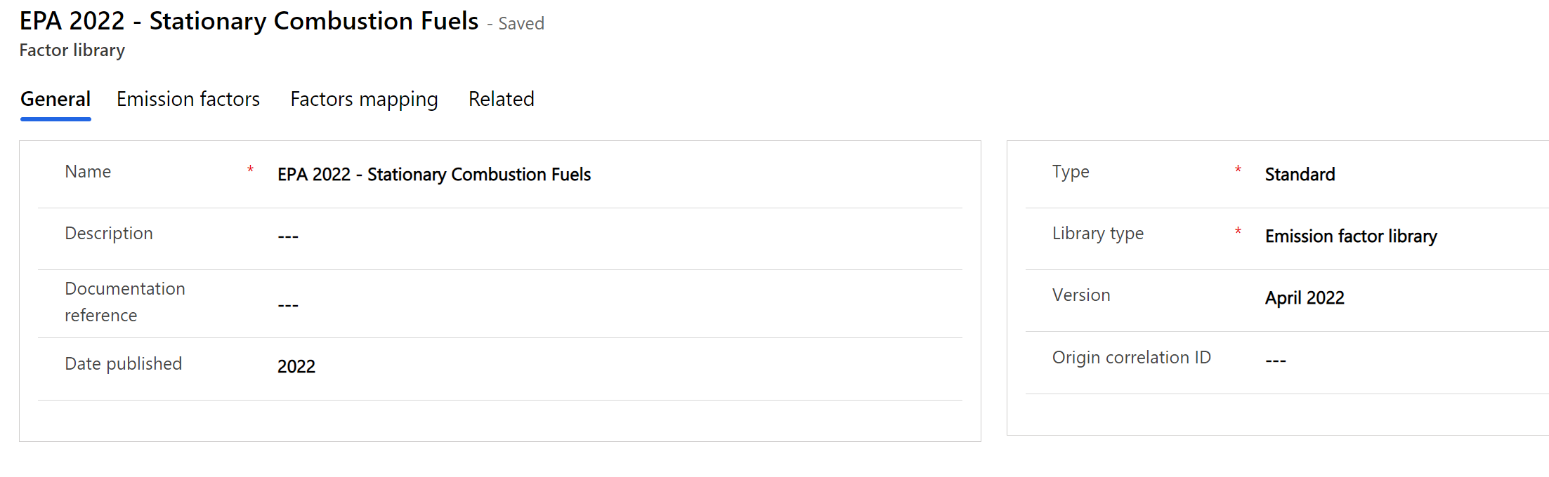
Libraries
A container of emission factors and factor mapping for specific year and version
Factor mapping will provide the flexibility to map factors based on the different reference data available in the solution.

Slide 75
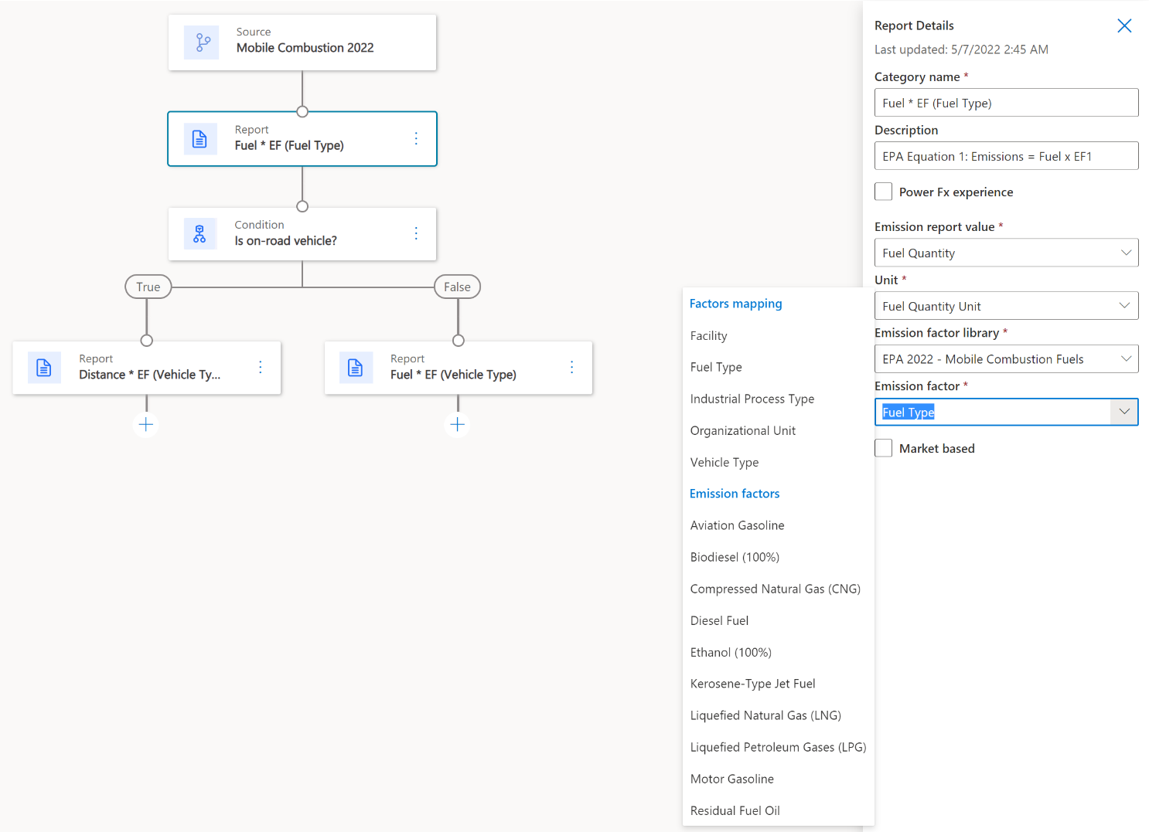
Factor mapping Dynamic calculations at scale
Let’s suppose we need to calculate mobile combustion for gas-powered passenger vehicles of all model years.
Identifying the correct emission factors can be done by either:
Mapping directly to specific emission factors by fuel type or
Mapping in advance using the library for all the fuel types and emission factors.
Scenario
Emission factor can be set directly in the formula as Gasoline Passenger Car 2000, and it will be used for the calculations in this formula, working only for this combination.
This approach requires creating several formulas according to fuel types available, ending with a complex setup.
Scenario
When selecting a Factor Mapping of Fuel Type (reference data), the formula will use the library to dynamically search for the factor, to find a match with the correct emission factor and fuel type for the activity.
This approach simplifies the number of formulas but requires defining a factor mapping in the library.
Notes:
Throughout the calculation model setup process, I’ve talked about emission factors. These can vary based on not just the emission source activity, but also on additional supporting data that can be found in Cloud for Sustainability, called Reference Data. Examples of reference data include facilities, fuel lists, and vehicles.
This combination of Reference Data and Emission factors creates what we call a factor mapping. Factor Mappings enable dynamic calculations at scale.
For example, if you have 100 facilities in different regions and with different emission factors, by creating a factor mapping to each emission factor based on the location of the facility, you can efficiently set up a single calculation model to support all 100 facilities.

Slide 76
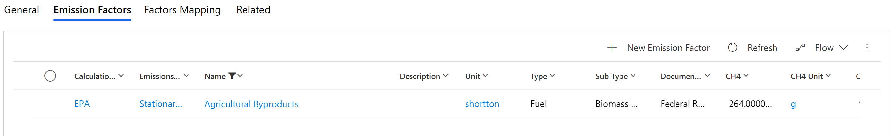
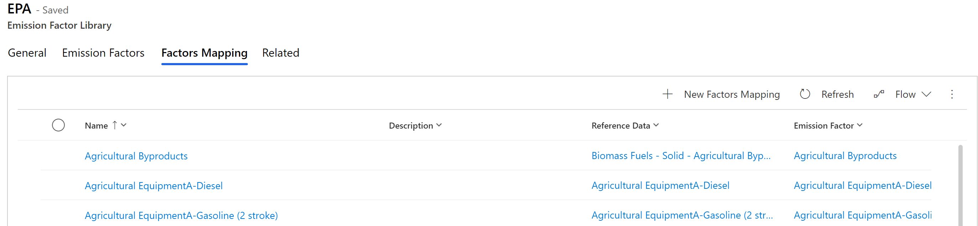
Factor mapping in library

Slide 77
Recommended practices Calculations
Pay special attention to factor mapping to optimize the number of models required.
Consider special naming conventions to support specialized calculations for facilities that have specific operations that require different emission factors.
Test first with small set of data and remove emissions data that produce errors. You can remove data in bulk directly in the emissions form or in make.powerapps.
Observe conversion units based on activity and model units, as missing conversions will cause errors during import.

Slide 78
What did we learn in Session 5?
How models, libraries, activity data, and profiles interact
Building a model
Building a profile
Using factor mapping

Slide 79
Give us your feedback
aka.ms/susbootcampsurvey

Slide 80
For resources and information about Microsoft Sustainability Manager, visit aka.ms/sustainabilityhub

Slide 81
Readiness bootcamp
Brandon Potter Group Product Manager, Microsoft Cloud for Sustainability
Alejandro Gutierrez Principal Product Manager, Microsoft Cloud for Sustainability
Rosie Mastrandrea Senior Director, Sustainability Product Marketing
Robin Smith Principal Product Manager, Microsoft Cloud for Sustainability

Slide 82
Session 6: Analytics, reporting and implementation
Analytics and reporting basics
Scorecards and goals
Implementation milestones

Slide 83
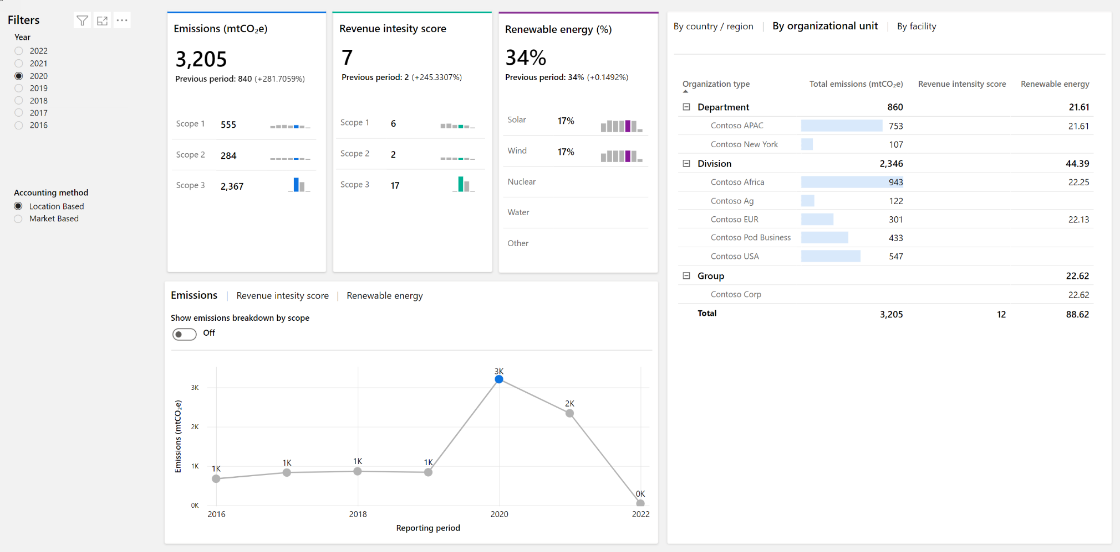
Analytics and reports
Architecture
Data refresh
Periods
Extensibility
Power BI and Data Lake managed by the service
Managed by the service and it runs periodically
All insights provides information on the last refresh indicated in the report
Reporting period start date is set under the organization unit setup and it will influence how data is grouped.
In the roadmap

Slide 84
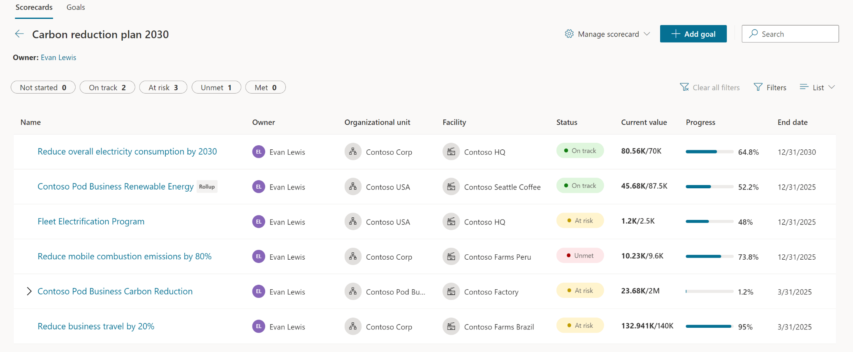
Scorecards and goals
Architecture
Data refresh
Goals
Scorecard and goals manually updated or connected to data for automatic check-ins with optional Teams collaboration.
When goals are connected to data, updates are managed by the service, and it runs periodically
Data driven or manual goals with connecting to data and setting rules for automatic status update.
Automatic check-ins
Several scorecards and goals and subgoals can be enabled.

Slide 85
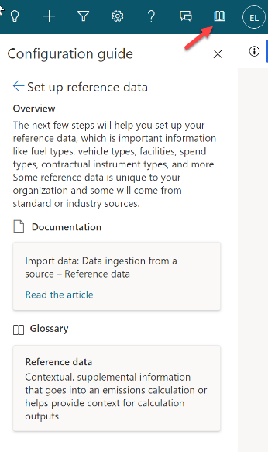

Milestones
Recommendations for implementing Sustainability Manager
Pro tip: Take advantage of the in-app configuration guide
Start simple and define a strategy considering organization and operational boundaries and data availability and formats.
Enable a pilot that allows you to visualize an end-to-end full cycle and demonstrate the value of the solution. Then, refine your strategy based on what you’ve learned. Connect it to specific scenarios so configuration and adoption can scale in future iterations as you bring in more activity from emissions sources and organization units/facilities.
Start small and keep growing. Take an incremental approach.
Solution scope
Implement
s Discovery
Incremental expansion for new activity from new emission sources
Operate
As you operate, consider continuous updates, so your solution is up to date with new capabilities
MILESTONE 2
MILESTONE 4
MILESTONE 1
MILESTONE 3
Pilot
Prepare
Continuously prepare your organization for adoption as you keep expanding on your organization

Slide 86
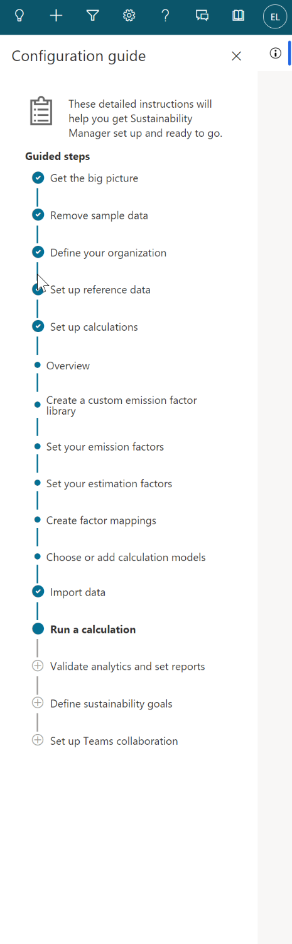
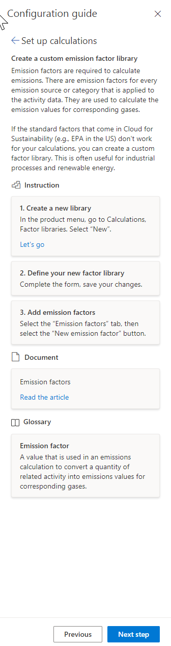






Sustainability Manager Configuration Guide
The guide provides the recommended configuration path to support success in adoption, helping organizations realize value faster
Contextual and actionable in-app guidance with assets for every step of the configuration journey
Different types of guidance artifacts are provided for each step, to provide an immersive experience
Instructions
Docs
Glossary
Step by step configuration instructions
Access to .docs articles in the context of the step
Contextual definitions used in the step
The guidance is actionable, including links to forms in context, documentation, and templates
Videos
Templates
Actionable
Short clips demonstrating the step (coming)
Templates with schema details for easy import of data (coming)
Dynamic prompts provide helpful resources when the user needs them
Templates
Get there faster using data templates
Download

Slide 87



What have we learned during this training?
The Microsoft sustainability story: Our journey and an introduction to Microsoft Cloud for Sustainability and Microsoft Sustainability Manager
Basic sustainability and carbon accounting concepts
How to deliver a product demo
Data ingestion process and the different methods to import data
Calculations engine and the flexibility to set dynamic calculations that can scale
Analytics and reports, scorecards and goals, and setting the foundation for the future with ML/AI- infused analytics
Recommendations for implementing the solution to bring value fast and improve earlier

Slide 88
Give us your feedback
aka.ms/susbootcampsurvey

Slide 89
For resources and information about Microsoft Sustainability Manager, visit aka.ms/sustainabilityhub

Slide 90
Readiness bootcamp
Brandon Potter Group Product Manager, Microsoft Cloud for Sustainability
Alejandro Gutierrez Principal Product Manager, Microsoft Cloud for Sustainability
Rosie Mastrandrea Senior Director, Sustainability Product Marketing
Robin Smith Principal Product Manager, Microsoft Cloud for Sustainability

Slide 91
Session 7: Telling the solution story
How to tell our story
Telling our story

Slide 92
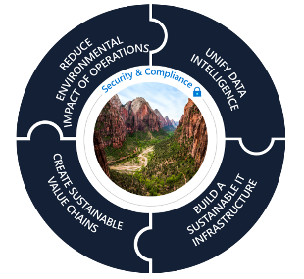
Our story is growing, quickly
October 2021 Public Preview
May/June 2022 General Availability (GA)*
July 2022 and beyond
Microsoft Cloud for Sustainability Public Preview
Microsoft Cloud for Sustainability
Our story has grown broader and stronger Microsoft Cloud for Sustainability now encompasses much more
Today, Microsoft Cloud for Sustainability represents a growing set of ESG (environmental, social, and governance) capabilities from Microsoft and our global ecosystem of partners that help organizations accelerate sustainability progress and business growth.
Now, we’re introducing Microsoft Sustainability Manager— a Microsoft Cloud for Sustainability solution.
In October 2021, we released Microsoft Cloud for Sustainability in Public Preview to help organizations record, report, and reduce their environmental impact.
Enabling stronger integration across our platform
Microsoft Sustainability Manager General Availability
Partner sustainability solutions built on the Microsoft Cloud
Emissions Impact Dashboard
Emissions Impact Dashboard for Microsoft 365
Dedicated water and waste services and solutions
Microsoft Sustainability Manager unifies data intelligence to help organizations monitor and manage their sustainability performance.
The Emissions Impact Dashboard provides Microsoft customers with transparency into emissions produced from their use of Microsoft Azure cloud services.
More Microsoft sustainability solutions
More partner sustainability solutions
* We expect GA of Microsoft Sustainability Manager to be announced on May 17, 2022, and effective June 1, 2022.
Notes:
In October 2021, we introduced Microsoft Cloud for Sustainability to help organizations record, report, and reduce their environmental impact.
Our story has grown. And today, Microsoft Cloud for Sustainability represents a growing set of ESG capabilities from Microsoft and our global ecosystem of partners that help organizations accelerate sustainability progress and business growth.
Now, we’re releasing Microsoft Sustainability Manager, a Cloud for Sustainability solution. It will be disclosed on May 17 with Microsoft Cloud for Sustainability and will be generally available to customers on June 1.
Microsoft Sustainability Manager unifies data intelligence to help organizations monitor and manage their sustainability performance.
We’re introducing partner solutions that will seamlessly connect into Microsoft Sustainability Manager.
The Emissions Impact Dashboard is available to provide Microsoft customers with transparency into the emissions Microsoft generates based on a customer’s use of Azure services.
And over the next few months, we’ll be rolling out additional Microsoft and partner solutions under Microsoft Cloud for Sustainability including the Emissions Impact Dashboard application for Microsoft 365.
There’s much more to come.

Slide 93
Microsoft sustainability top line messaging orientation
There are three tiers of messaging, useful for different altitudes of discussion
1
2
3
Thought leadership
Via a connected conversation
To address a BDM need
Microsoft sustainability story
Microsoft Cloud for Sustainability story
Microsoft Sustainability Manager story
Internal
Summary of the overall Microsoft industry point-of-view and thought leadership
Scenarios allow us to have a conversation with the customer relevant to their sustainability priorities
Presents solution to address pain points of BDMs responsible for demonstrating sustainability performance
Build a more sustainable future, together
Accelerate your sustainability journey
Monitor and manage your sustainability performance
External tagline
Wherever you are in your sustainability journey, together, we can accelerate progress to reach our collective ESG (environmental, social, and governance) goals and create new value for your organization.
Microsoft Cloud for Sustainability empowers organizations to accelerate sustainability progress and business growth by bringing together a growing set of ESG (environmental, social, and governance) capabilities from Microsoft and our global ecosystem of partners.
Microsoft Sustainability Manager is an extensible solution that enables organizations to more easily record, report, and reduce their environmental impact through increasingly automated data connections that deliver actionable insights.
External topline message

Slide 94
Wherever you are in your sustainability journey, together, we can accelerate progress to reach our collective goals
Accelerate our shared sustainability journey
With over a decade of sustainability experience and continuous innovation integrated into our technology, using Microsoft products can help you decarbonize and accelerate your ESG (environmental, social, governance) journey
Embed sustainability in everything you do
With our technology and partner ecosystem, we bring integrated solutions to connect organizations and their value chain
Create new value with sustainability
We’re creating a community of collective learning and action, where data can be shared, insights delivered, and more common ways of working can be created

Slide 95
Accelerate sustainability progress and business growth Microsoft Cloud for Sustainability
Security & Compliance
Reduce environmental Impact of operations
Unify DATA INTELLIGENCE
CREATE sustainable value chains
Build A sustainable it infrastructure

Slide 96
Accelerate sustainability progress and business growth Microsoft Cloud for Sustainability
Microsoft Sustainability Manager
Security & Compliance
Reduce environmental Impact of operations
Unify DATA INTELLIGENCE
CREATE sustainable value chains
Build A sustainable it infrastructure

Slide 97
Our story is growing, quickly
October 2021 Public Preview
May/June 2022 General Availability (GA)*
July 2022 and beyond
Microsoft Cloud for Sustainability Public Preview
Microsoft Cloud for Sustainability
Our story has grown broader and stronger Microsoft Cloud for Sustainability now encompasses much more
Today, Microsoft Cloud for Sustainability represents a growing set of ESG (environmental, social, and governance) capabilities from Microsoft and our global ecosystem of partners that help organizations accelerate sustainability progress and business growth.
Now, we’re introducing Microsoft Sustainability Manager— a Microsoft Cloud for Sustainability solution.
In October 2021, we released Microsoft Cloud for Sustainability in Public Preview to help organizations record, report, and reduce their environmental impact.
Enabling stronger integration across our platform
Microsoft Sustainability Manager General Availability
Partner sustainability solutions built on the Microsoft Cloud
Emissions Impact Dashboard
Emissions Impact Dashboard for Microsoft 365
Dedicated water and waste services and solutions
Microsoft Sustainability Manager unifies data intelligence to help organizations monitor and manage their sustainability performance.
The Emissions Impact Dashboard provides Microsoft customers with transparency into emissions produced from their use of Microsoft Azure cloud services.
More Microsoft sustainability solutions
More partner sustainability solutions
* We expect GA of Microsoft Sustainability Manager to be announced on May 17, 2022, and effective June 1, 2022.
Notes:
In October 2021, we introduced Microsoft Cloud for Sustainability to help organizations record, report, and reduce their environmental impact.
Our story has grown. And today, Microsoft Cloud for Sustainability represents a growing set of ESG capabilities from Microsoft and our global ecosystem of partners that help organizations accelerate sustainability progress and business growth.
Now, we’re releasing Microsoft Sustainability Manager, a Cloud for Sustainability solution. It will be disclosed on May 17 with Microsoft Cloud for Sustainability and will be generally available to customers on June 1.
Microsoft Sustainability Manager unifies data intelligence to help organizations monitor and manage their sustainability performance.
We’re introducing partner solutions that will seamlessly connect into Microsoft Sustainability Manager.
The Emissions Impact Dashboard is available to provide Microsoft customers with transparency into the emissions Microsoft generates based on a customer’s use of Azure services.
And over the next few months, we’ll be rolling out additional Microsoft and partner solutions under Microsoft Cloud for Sustainability including the Emissions Impact Dashboard application for Microsoft 365.
There’s much more to come.

Slide 98
Our sustainability story

Slide 99
Decades of action
Our history 2009-2019
Our commitments 2020-2050
AI for Earth launch
LEED Gold certification for new datacenters
Carbon fee raised to $15
Water replenishment goal set
100% carbon neutral
Internal carbon fee instituted
2030
2025
Become carbon negative
Operate with 100% renewable energy
2009
2012
2016
2017
2018
2019
2030
2050
Become zero waste
Remove all historic emissions
2025
First carbon emission reduction goal
Zero-waste campus certification
Supplier carbon engagement in China launched
Net zero potable water Silicon Valley campus groundbreaking
Protect more land than Microsoft uses
2030
Become water positive

Slide 100
Wherever you are in your sustainability journey, together, we can accelerate progress to reach our collective goals
Accelerate our shared sustainability journey
With over a decade of sustainability experience and continuous innovation integrated into our technology, using Microsoft products can help you decarbonize and accelerate your ESG (environmental, social, governance) journey
Embed sustainability in everything you do
With our technology and partner ecosystem, we bring integrated solutions to connect organizations and their value chain
Create new value with sustainability
We’re creating a community of collective learning and action, where data can be shared, insights delivered, and more common ways of working can be created

Slide 101
Microsoft Cloud for Sustainability accelerates sustainability progress and business growth
Unify data intelligence
Build a sustainable IT infrastructure
Reduce environmental impact of operations
Create sustainable value chains
Notes:
Microsoft Cloud for Sustainability empowers organizations to accelerate sustainability progress and business growth by bringing together a set of environmental, social, and governance capabilities across the Microsoft cloud portfolio plus solutions from our global ecosystem of partners.
Working closely with our customers and partners, we start with:
Unifying data intelligence to drive sustainability reporting, sustainability efforts, and business transformation, and
Identifying opportunities to build a more sustainable infrastructure by replacing tools, systems, or activities with more efficient options to minimize their footprint
And through our work with partners using advanced analytics, machine learning, and virtual models in the cloud, we’re helping organizations:
Reduce the environmental footprint of their operational systems and processes, and
Create sustainable value chains by facilitating greater transparency and accountability, from raw materials to product creation to distribution.
Accurate, reliable data intelligence is critical for the success of these initiatives. And for an organization to truly make progress toward accelerating their sustainability progress and business growth, they need better visibility and transparency into the environmental footprint of their entire operations, their products, the activities of their people, and their value chain.
We’ve seen this ourselves, in our own journey.
<CLICK>

Slide 102
Microsoft Sustainability Manager
DATA
Record
Unify data intelligence to help you monitor and manage your sustainability performance
INSIGHTS
Report
ACTION Reduce

Slide 103

Resources
Learn
Aka.ms/CloudforSustainabilityReadiness
Microsoft Cloud for Sustainability Readiness Bootcamp
Microsoft Cloud for Sustainability LearnFest (April ‘22)
Aka.ms/SustainabilityReadiness
Sustainability in Action Badge training
Selling Sustainability on-demand training suite
Resources
Aka.ms/SustainabilityHub
Internal and external go-to-market materials
Industry L100 presentations for sustainability
Customer opportunity
Microsoft Sustainability Manager free trial Aka.ms/MSMtrial
Service line offerings:
Digital strategy for sustainability
Sustainability data management and insights
Sign up for Microsoft sustainability updates Aka.ms/Sus-Stay-Informed
If you have additional questions, contact Aka.ms/SusInquiry or the Sustainability Connected Community

Slide 104
For resources and information about Microsoft Sustainability Manager, visit aka.ms/sustainabilityhub

